Slide 1
RDBMS Concepts
Surendran Velath

Slide 2
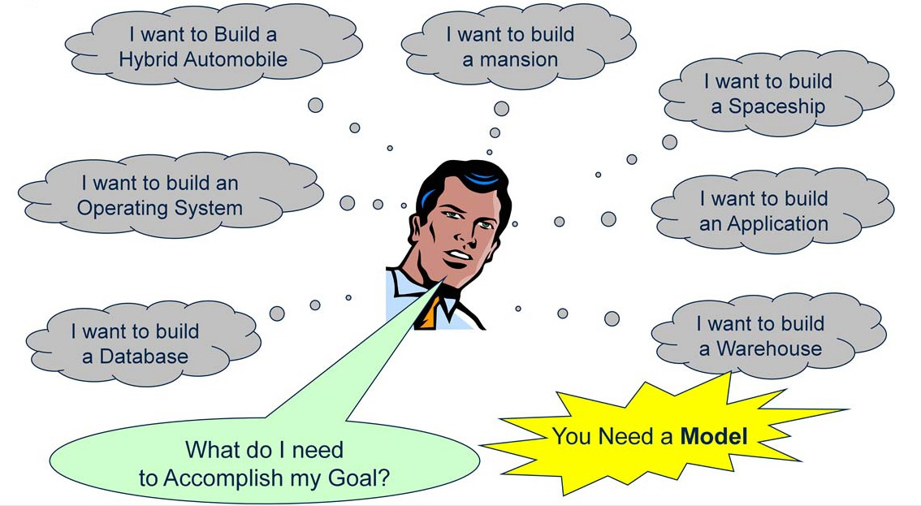
Introduction to Data Models

Slide 3
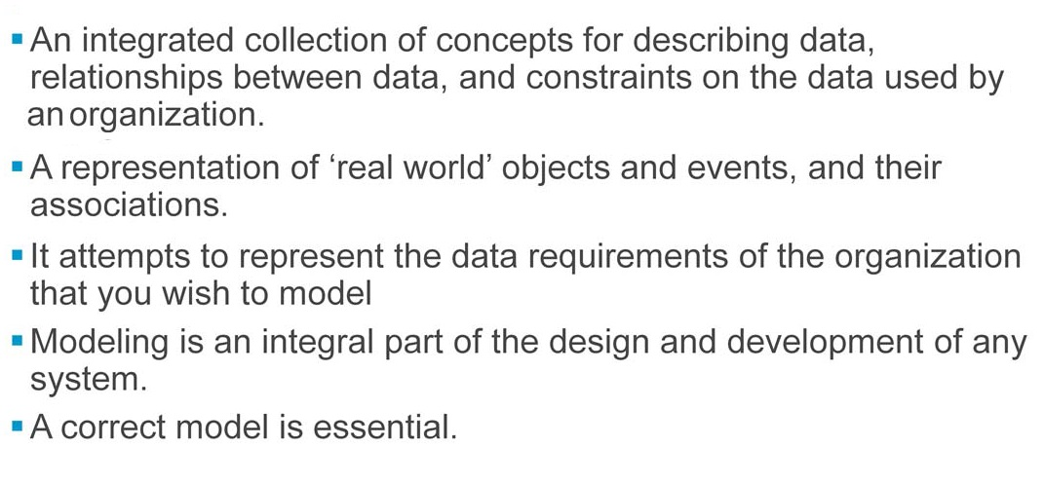
Definition of a Model

Slide 4
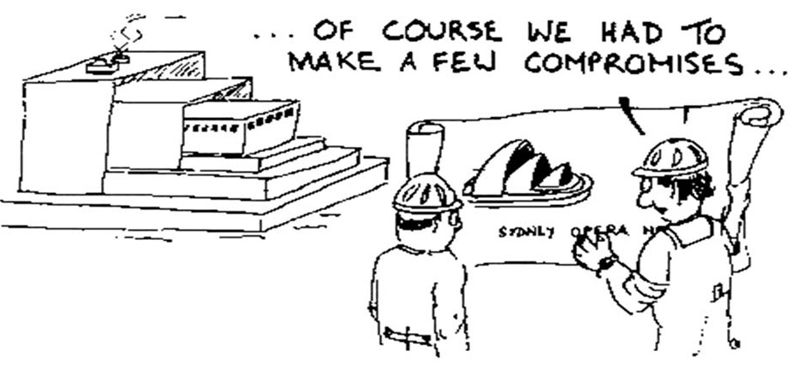
Essentiality of Correct Model

Slide 5
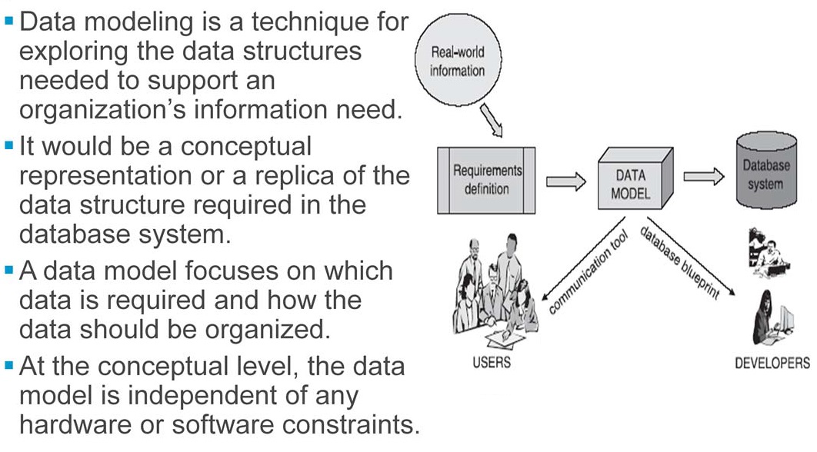
What is data modeling?

Slide 6
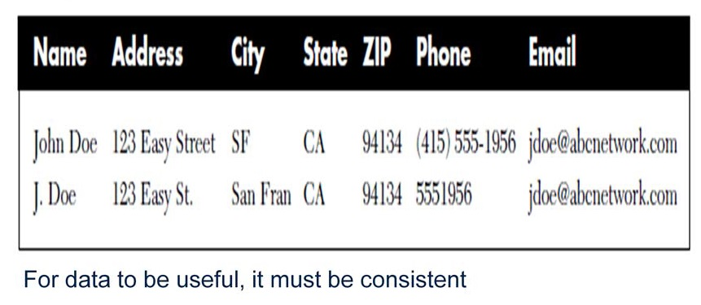
Data inconcistency

Slide 7
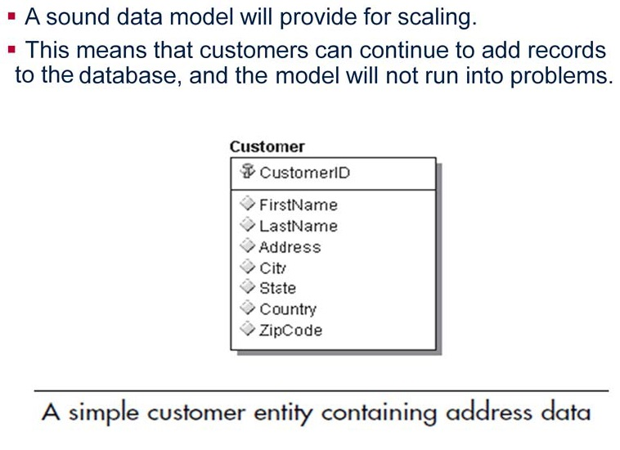
Scalability

Slide 8
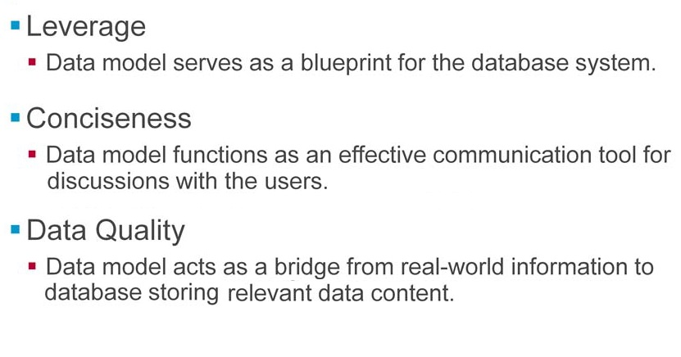
Data model need

Slide 9
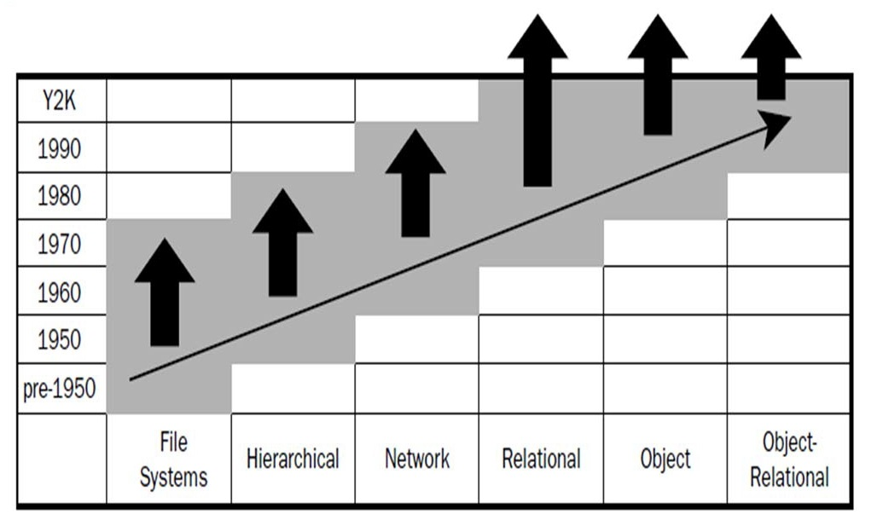
Data modeling evolution

Slide 10
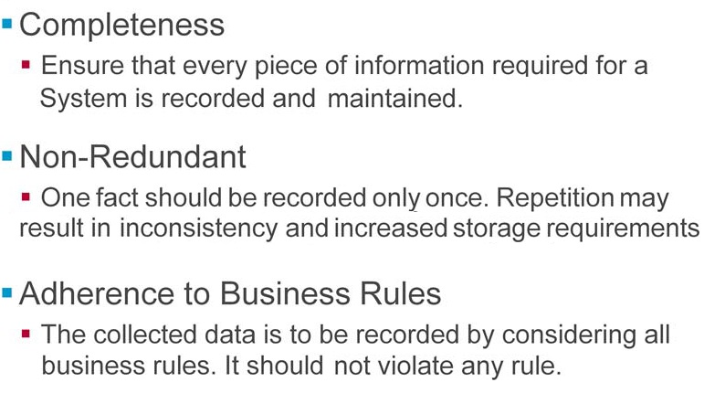
Data model features

Slide 11
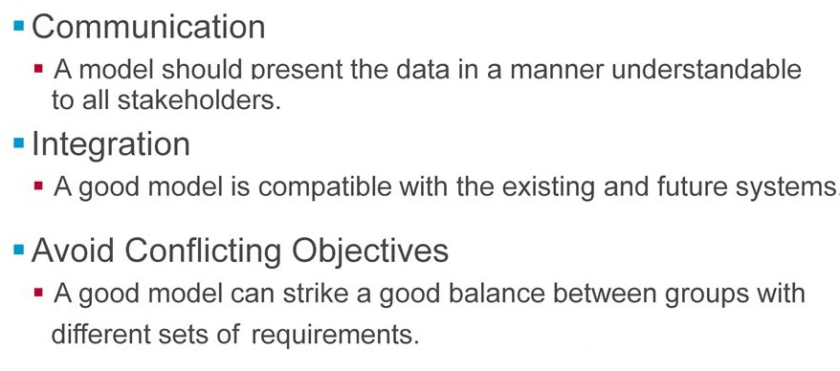
Data model features

Slide 12
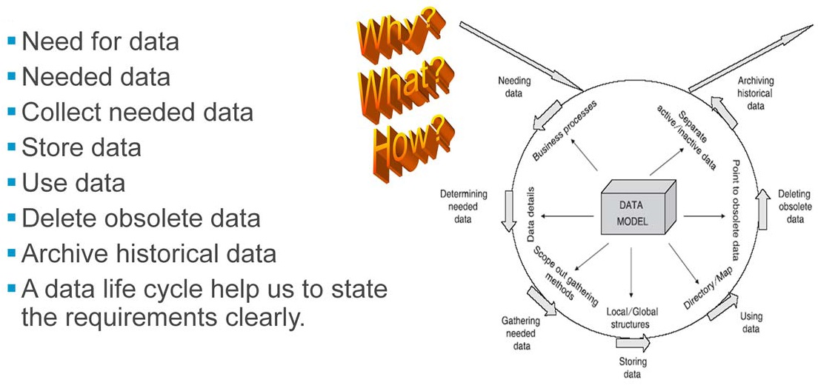
Data Life Cycle

Slide 13
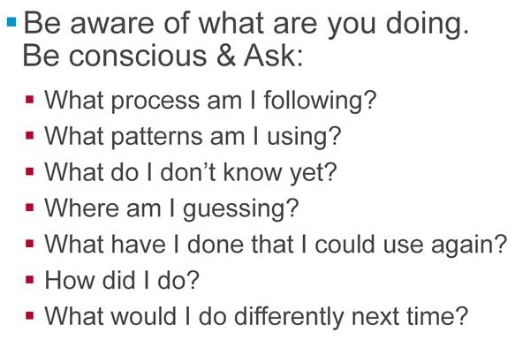
Designing Model

Slide 14
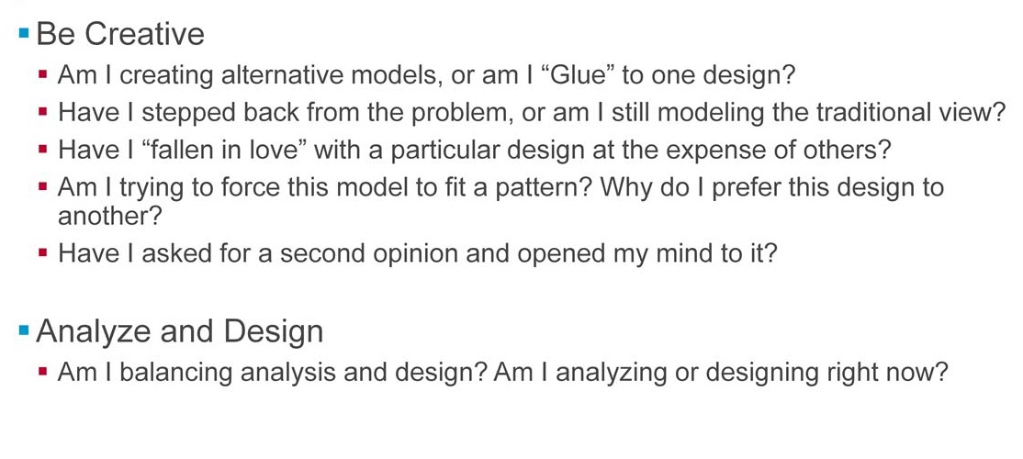
Designing Model

Slide 15
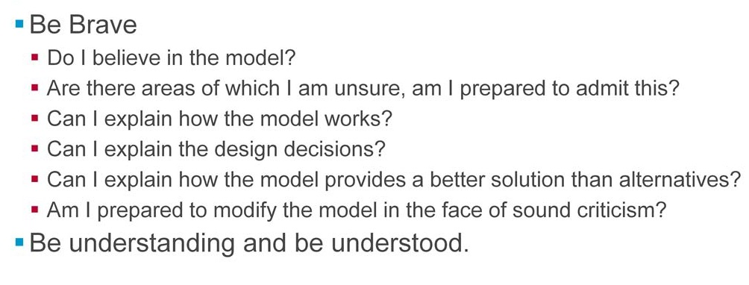
Designing Model

Slide 16
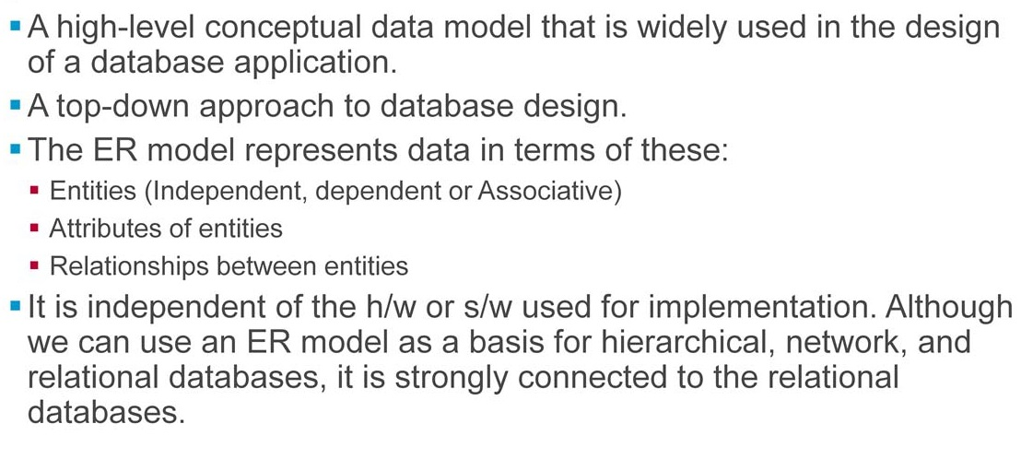
Entity Relationship Model

Slide 17
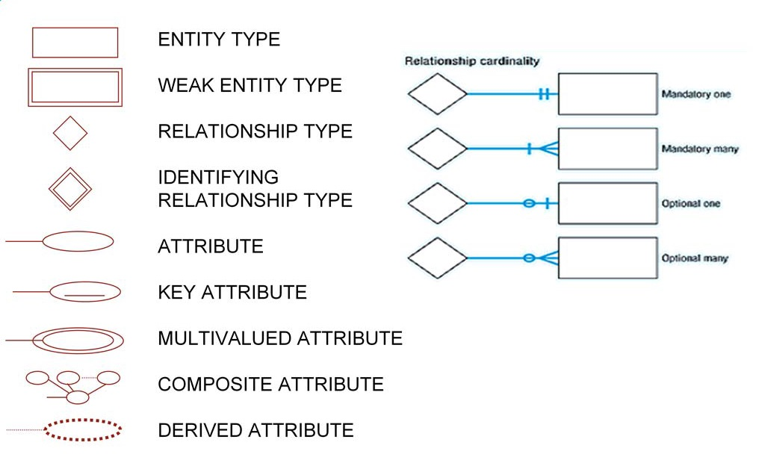
ER Model Notations

Slide 18
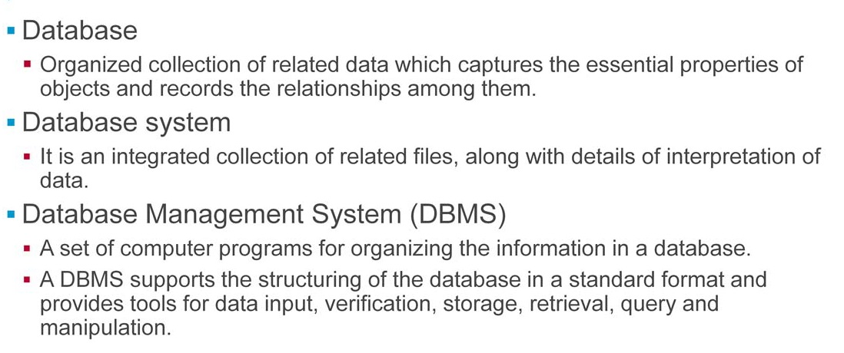
Database

Slide 19
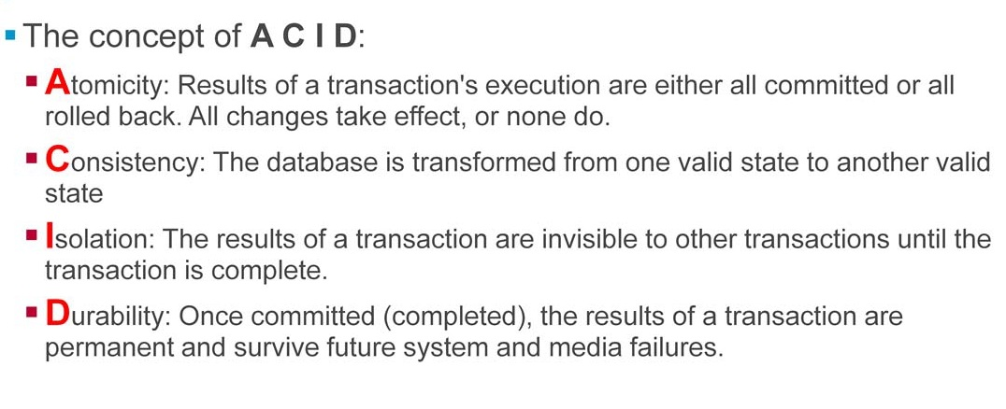
ACID Properties

Slide 20
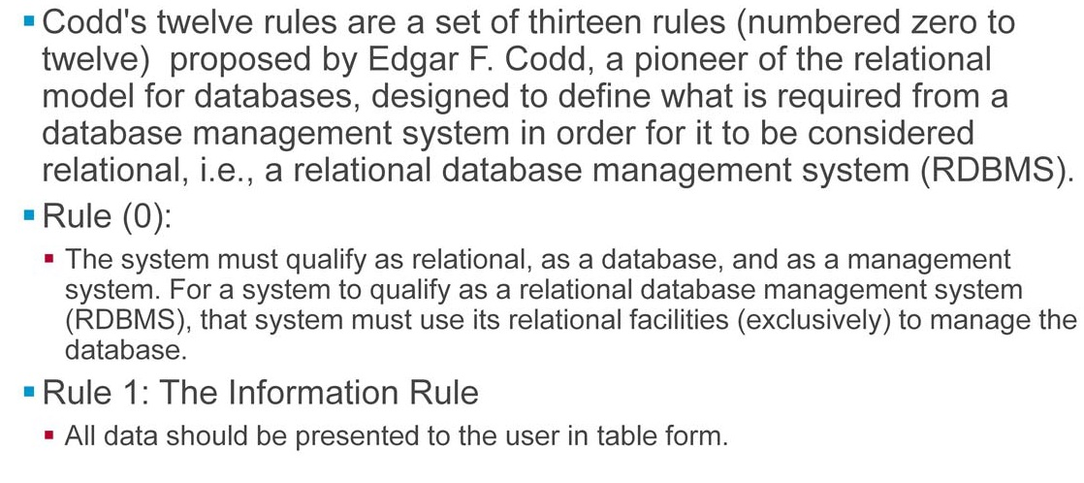
CODD's Rules

Slide 21
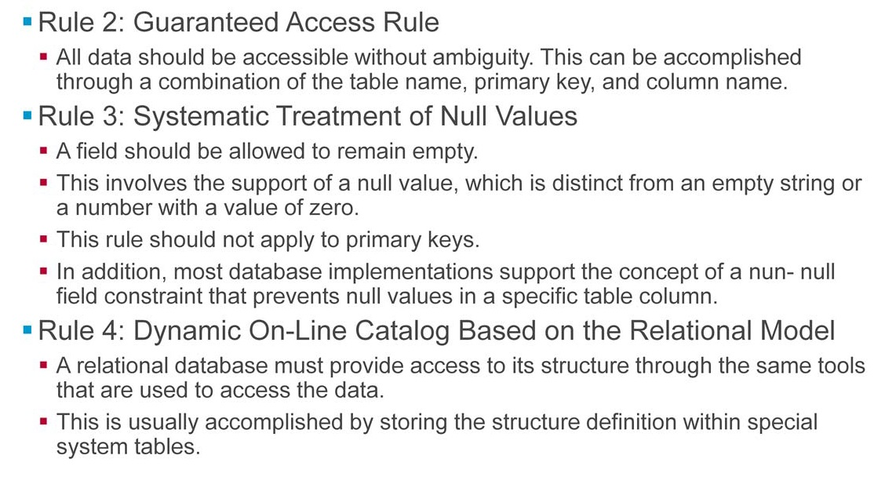
CODD's Rules

Slide 22
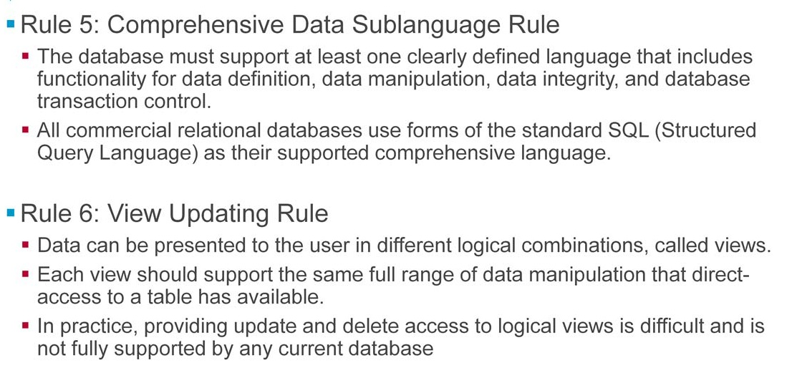
CODD's Rules

Slide 23
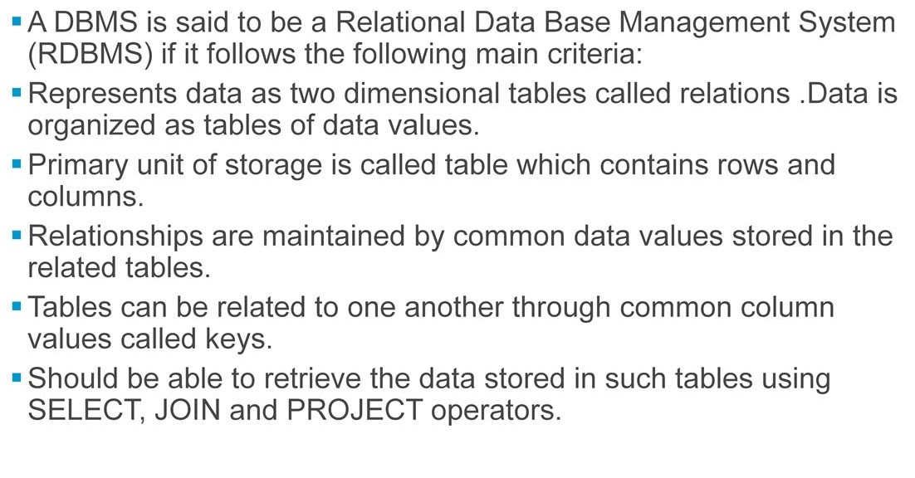
Relational DBMS

Slide 24
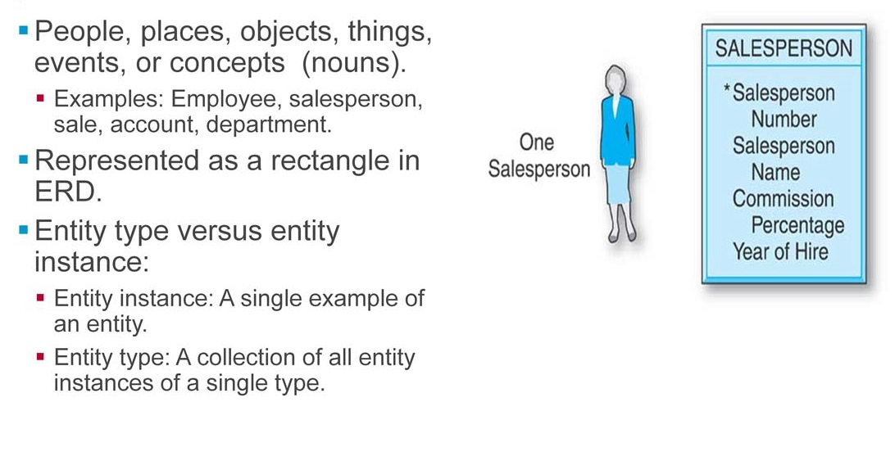
Entities

Slide 25
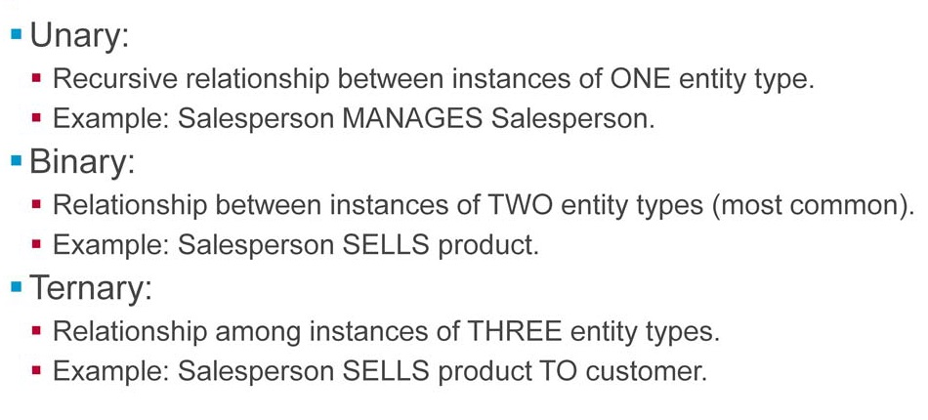
Degree of Relationship

Slide 26
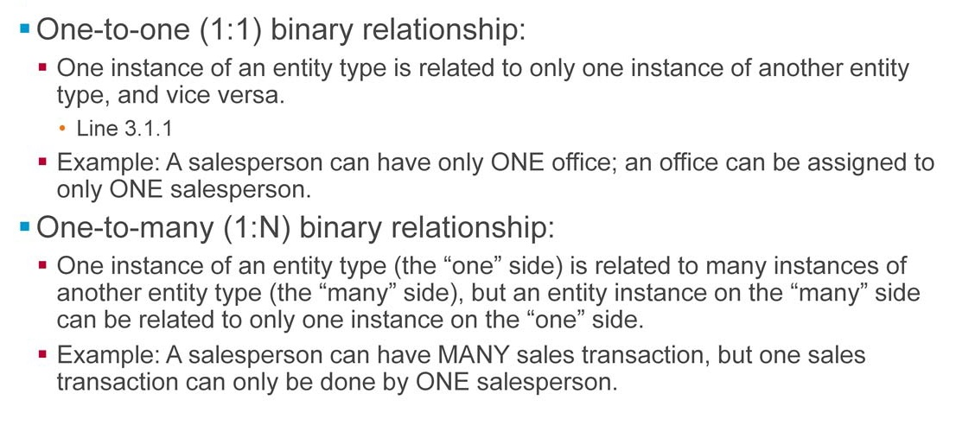
Types of binary relationship

Slide 27
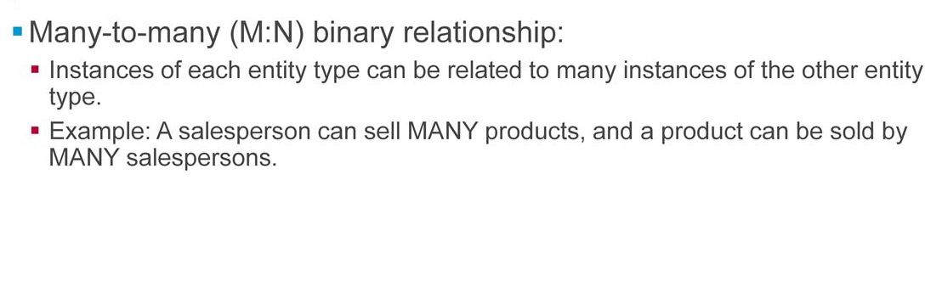
Types of binary relationship

Slide 28
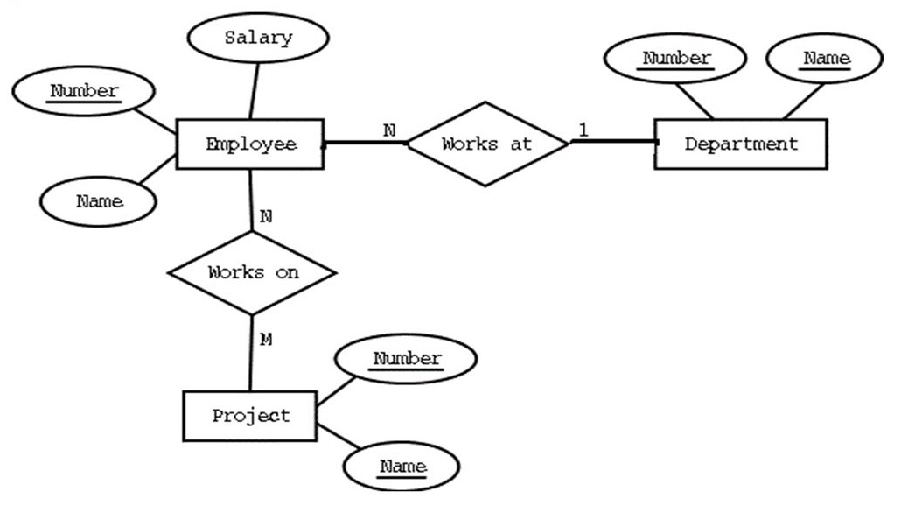
ER Model

Slide 29
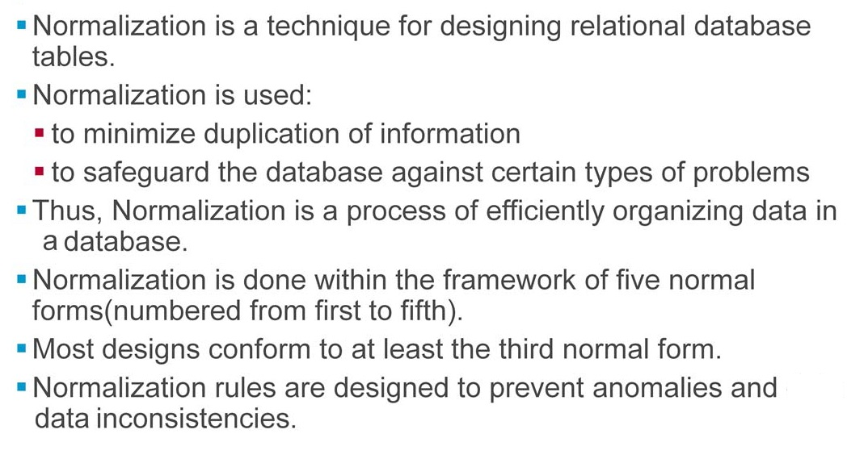
Normalization Concepts

Slide 30
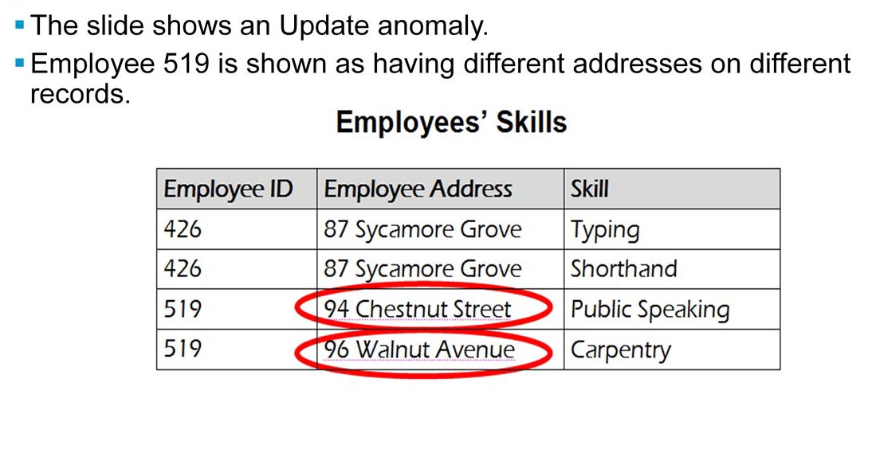
Update Anomaly

Slide 31
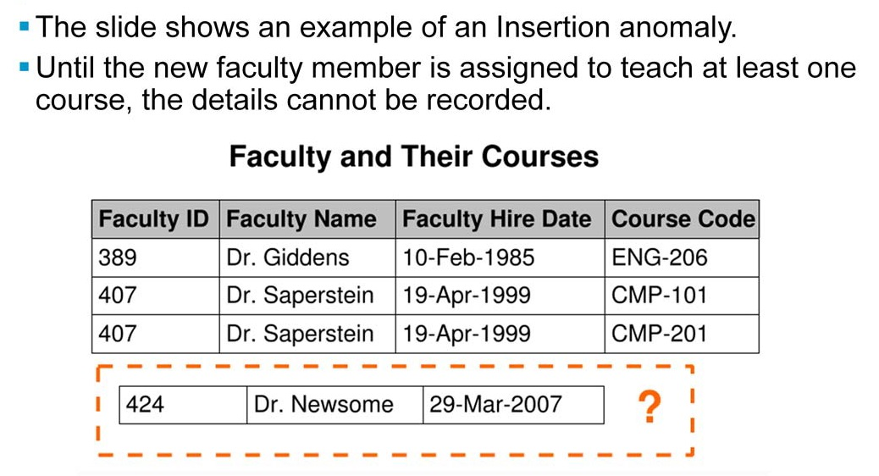
Insertion Anomaly

Slide 32
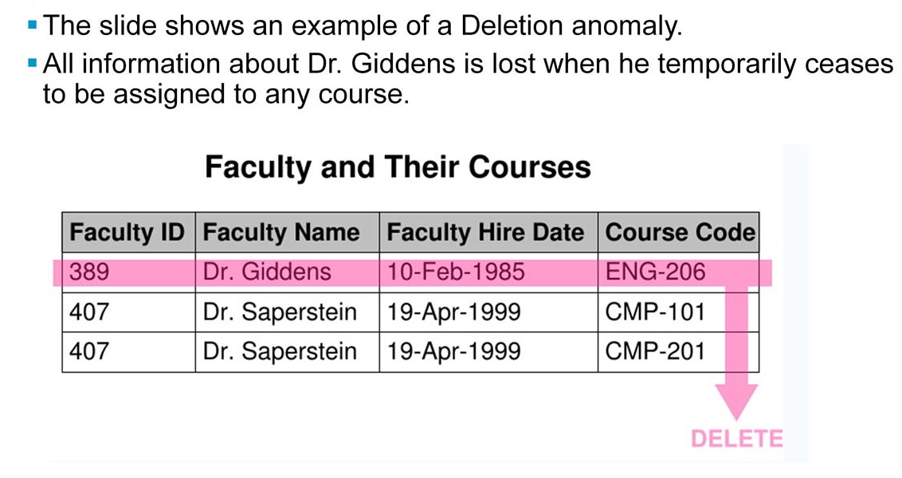
Deletion Anomaly

Slide 33
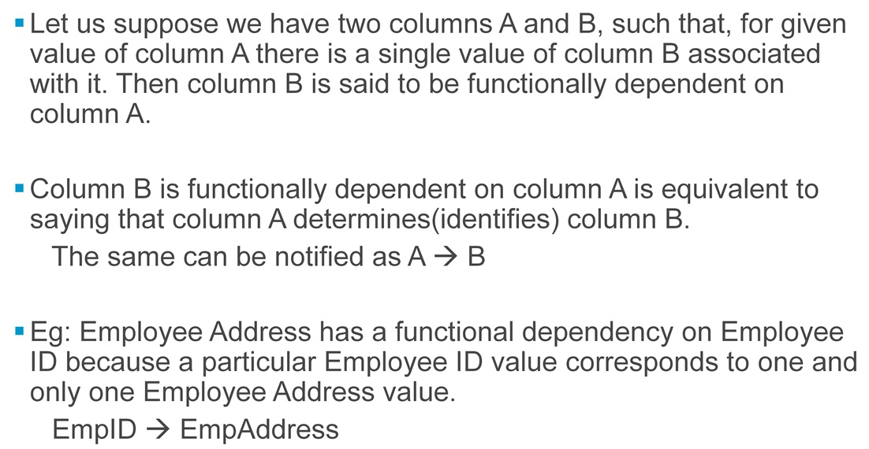
Functional Dependency

Slide 34
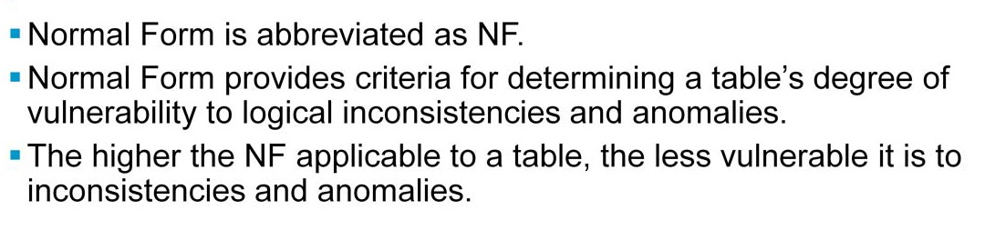
Normal Form

Slide 35
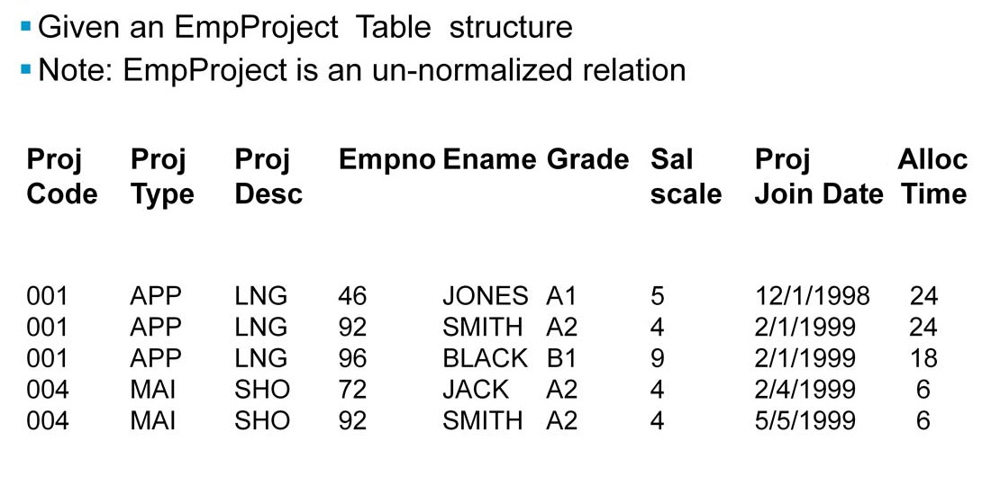
Case Study: Normalization

Slide 36
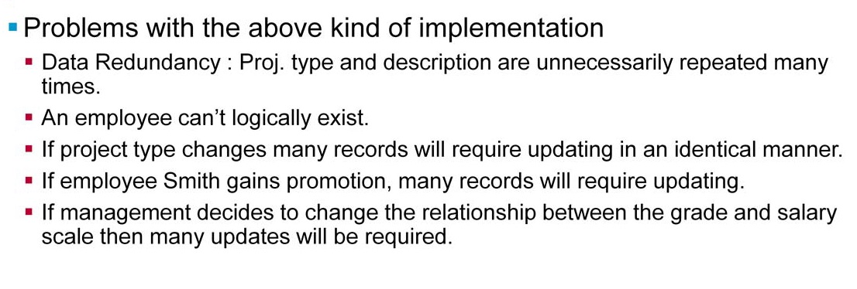
Case Study: Normalization

Slide 37
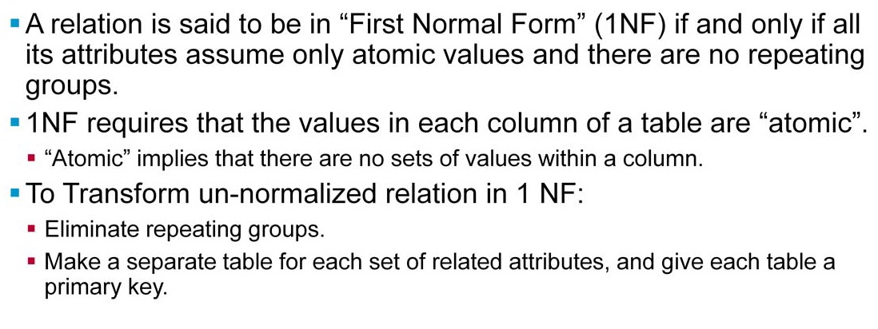
First Normal Form (1NF)

Slide 38
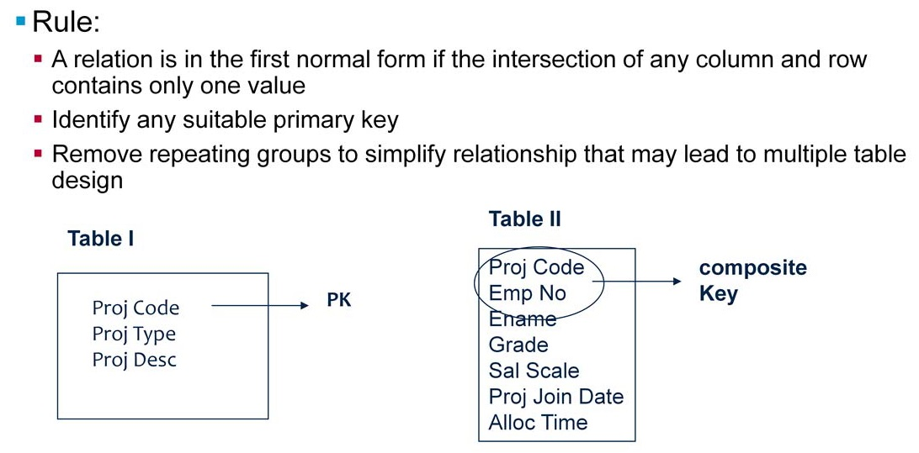
First Normal Form (1NF)

Slide 39
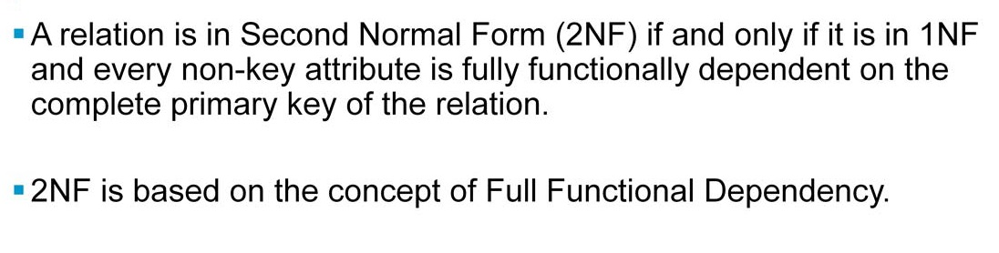
Second Normal Form (2NF)

Slide 40
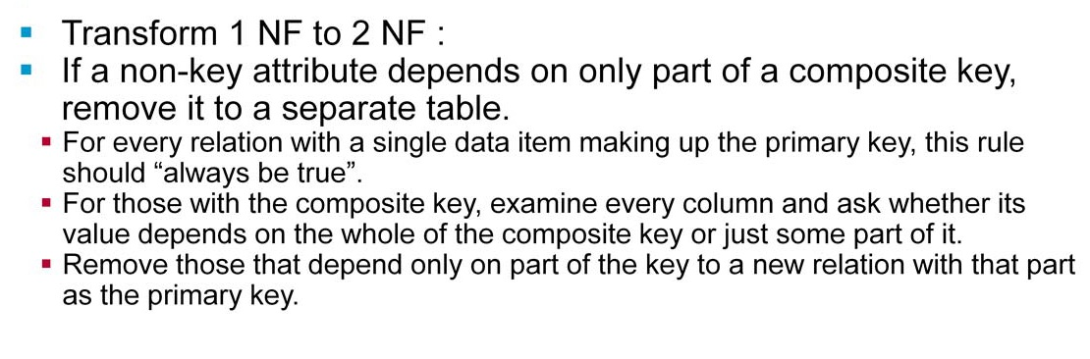
Second Normal Form (2NF)

Slide 41
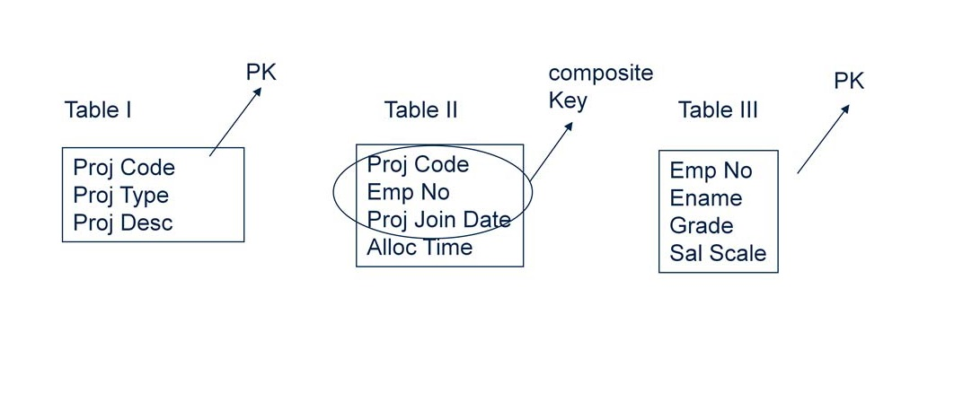
Second Normal Form (2NF)

Slide 42
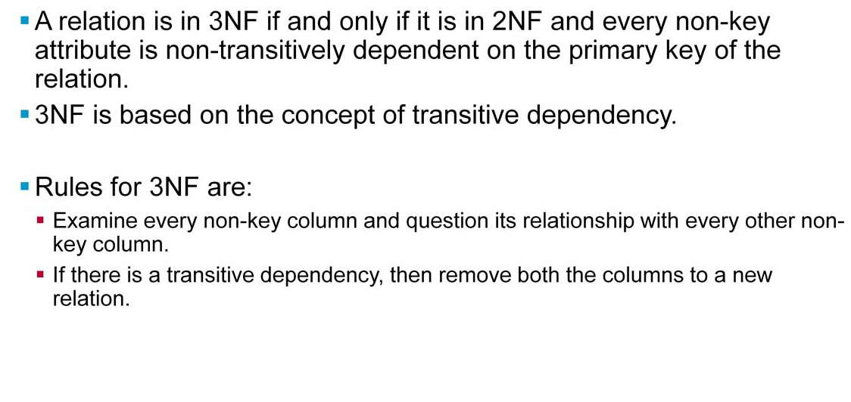
Third Normal Form (3NF)

Slide 43
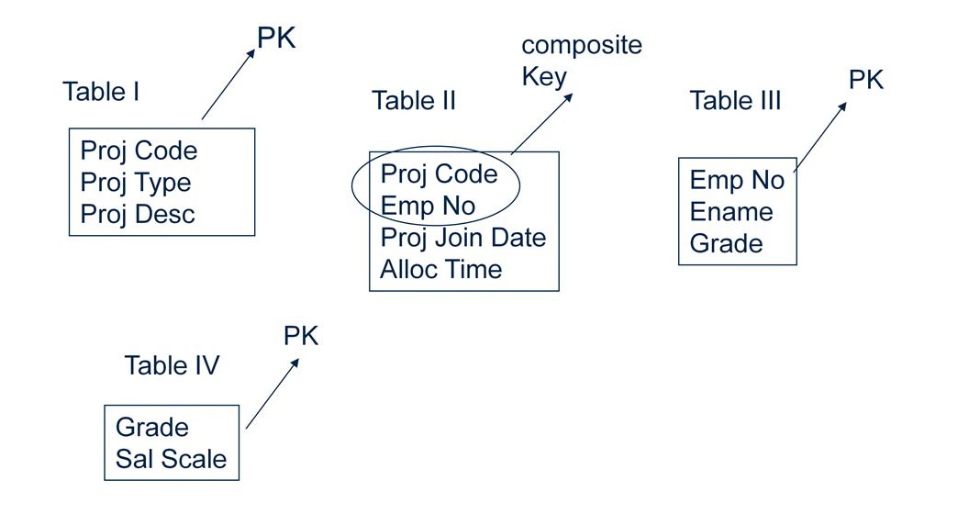
Third Normal Form (3NF)

